Slide 1
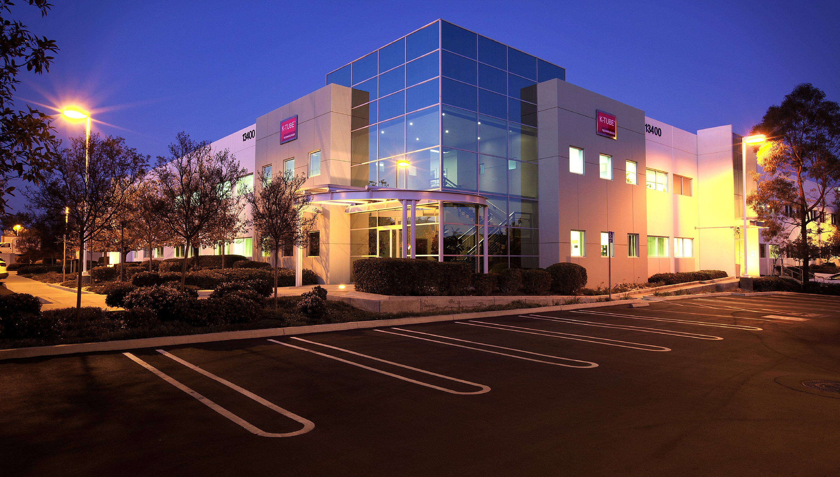

K-TU TECHNOLOG S
Manufacturing stainless steel tubing for more than 40 years.

Slide 2
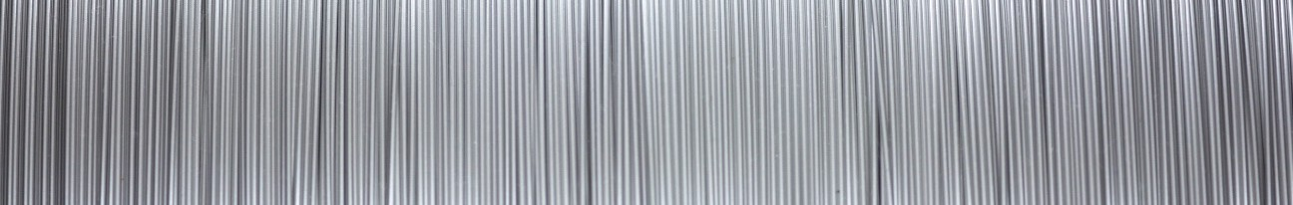
How It’s Made
STAINLESS STEEL TUBING
SLITTING
FORMING & LASER WELDING
HEAT TREATING
STRAIGHTENING
CLEANING
PACKAGING
SINKING
PLUGGING
CENTERLESS GRINDING
CUTTING
INSPECTION
FIBER OPTIC FILLED TUBING

Slide 3
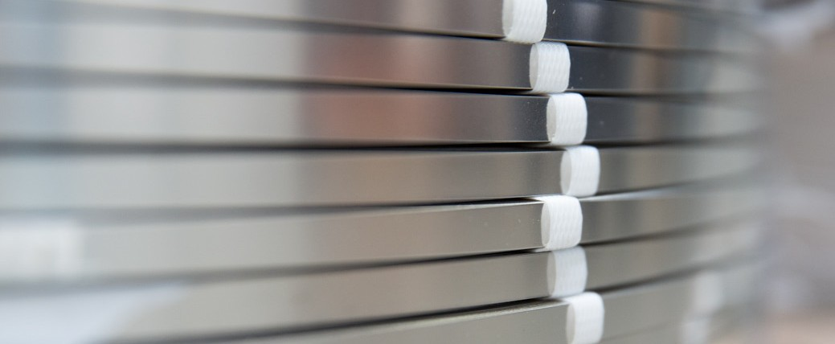
PROCESS
SLITTING
Performed by approved suppliers
Strict specifications ensure repeatability
Coils supplied in long lengths

Slide 4
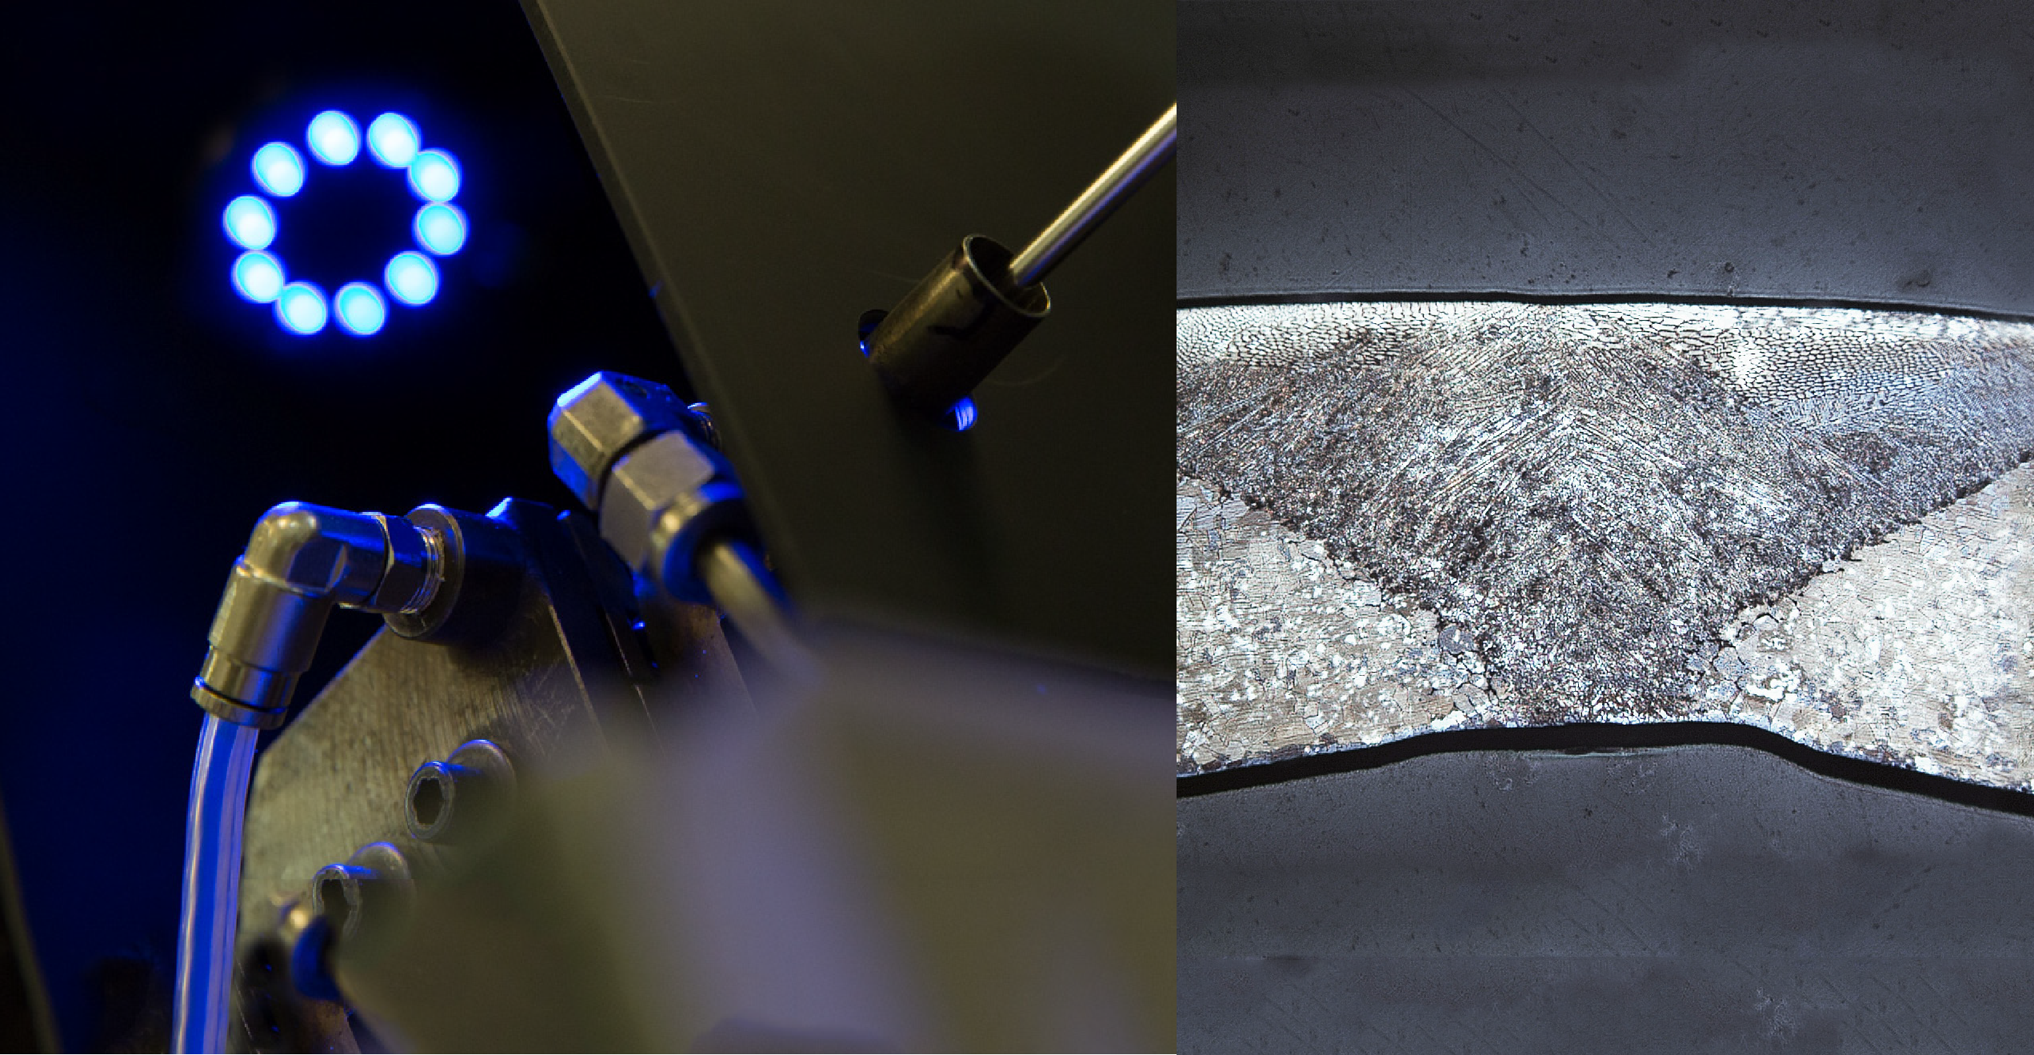
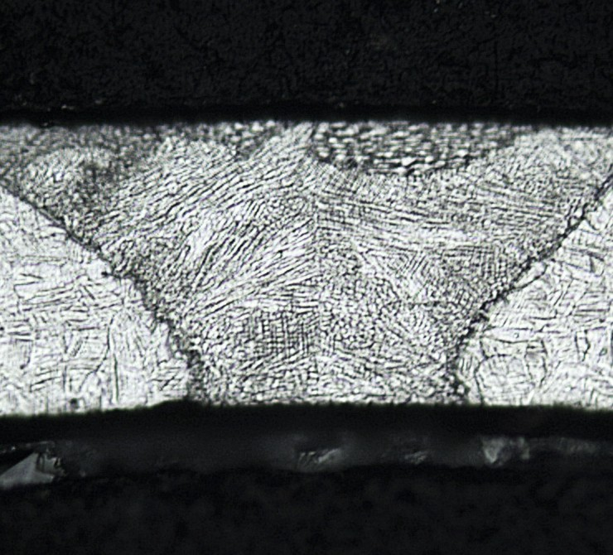
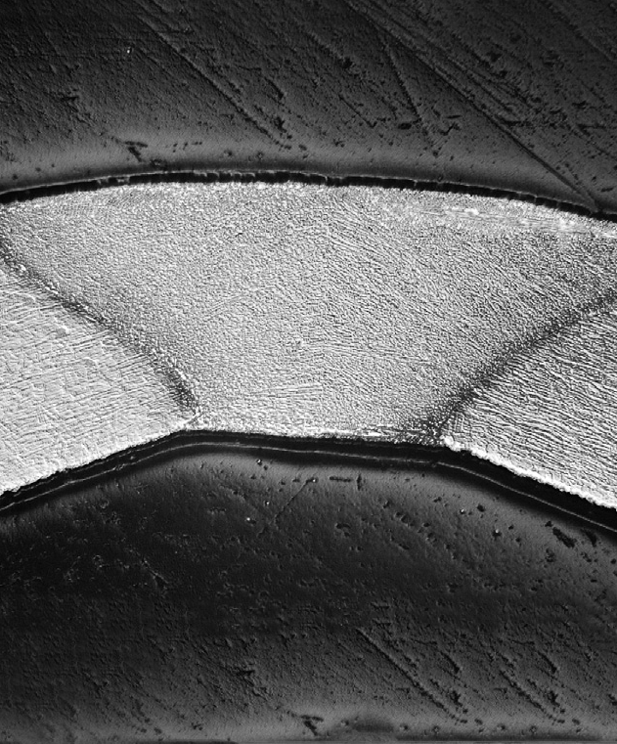
PROCESS
FORMING & LASER WELDING
Precision roll forming mills create uniform product.
Defect detection is integrated into the process.
The strip is welded into coils in a continuous process.

Slide 5
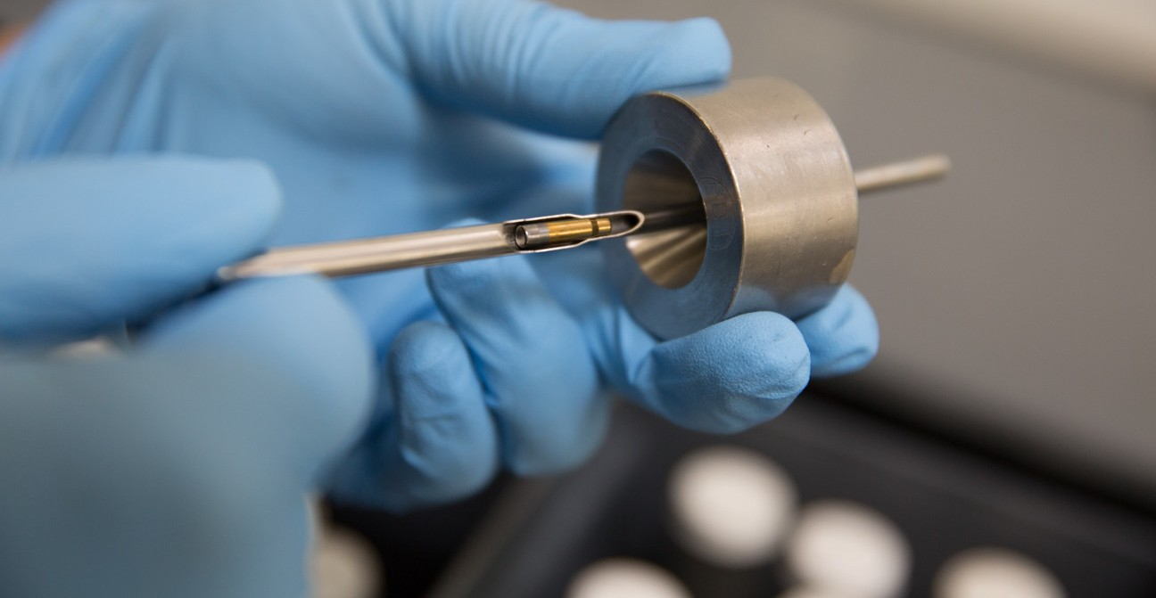
PROCESS
PLUGGING
This process fine tunes wall thickness to tight tolerances.
The floating plug smooths the finish of the ID.
The surface finish is determined by the percent of plugging vs. sinking.
This is the primary technology used in Brite Draw and Matte products.

Slide 6
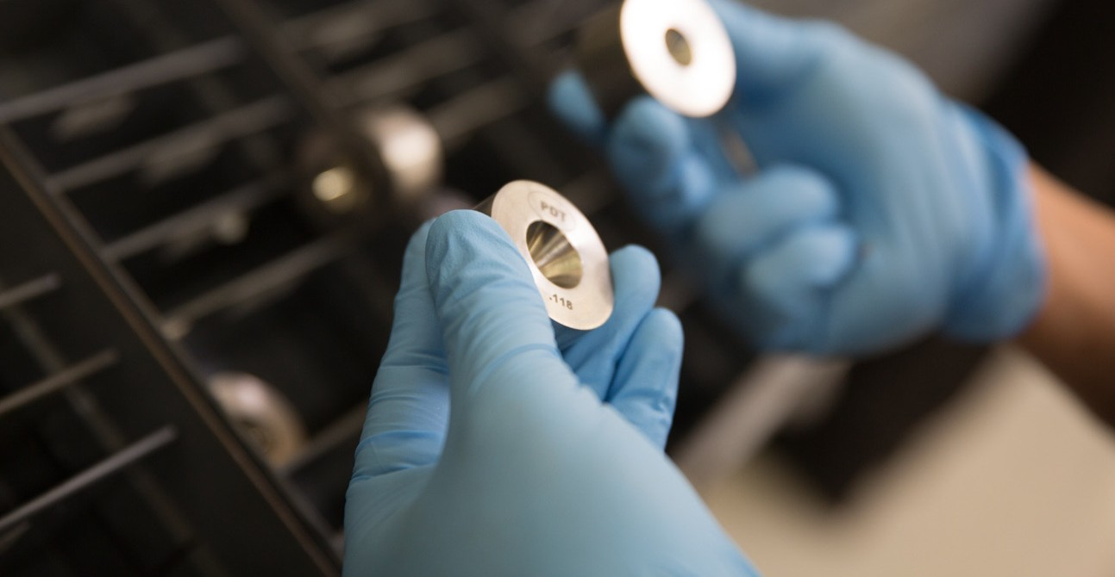
PROCESS
SINKING
The tubing’s outside diameter is reduced through a series
of dies.
Reduction causes cold work, which increases tensile strength.
This is the primary technology used in K-Form products.

Slide 7
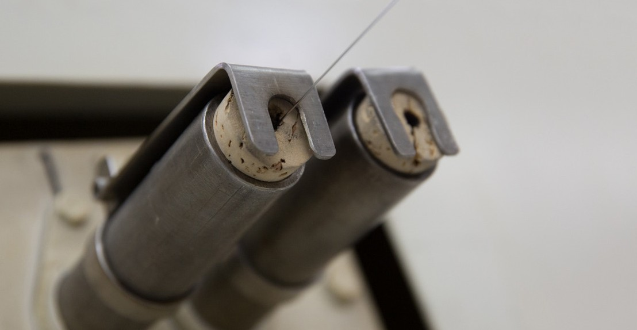
PROCESS
HEAT TREATING
Heat treating tailors custom material properties.
Annealing relieves stress and allows for more reduction.
The coils are heat treated inline.

Slide 8
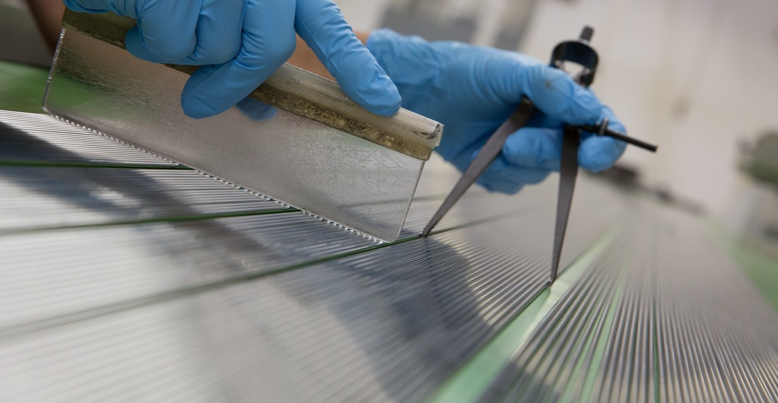
PROCESS
STRAIGHTENING
A rotary straightener balances internal stress to remove coil cast.
Parts are visually inspected after straightening.

Slide 9
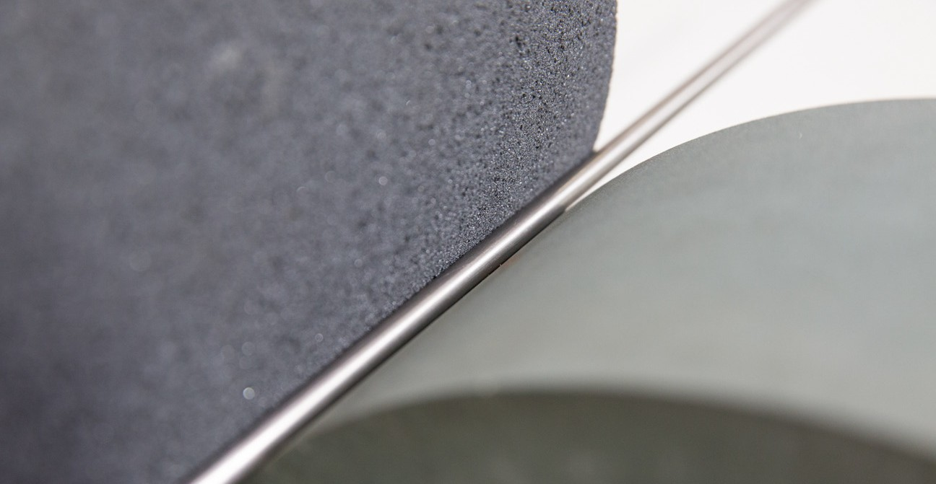
PROCESS
CENTERLESS GRINDING
This equipment can hold tight OD tolerances.
Grinding removes wall thickness for high OD/wall ratio designs.

Slide 10
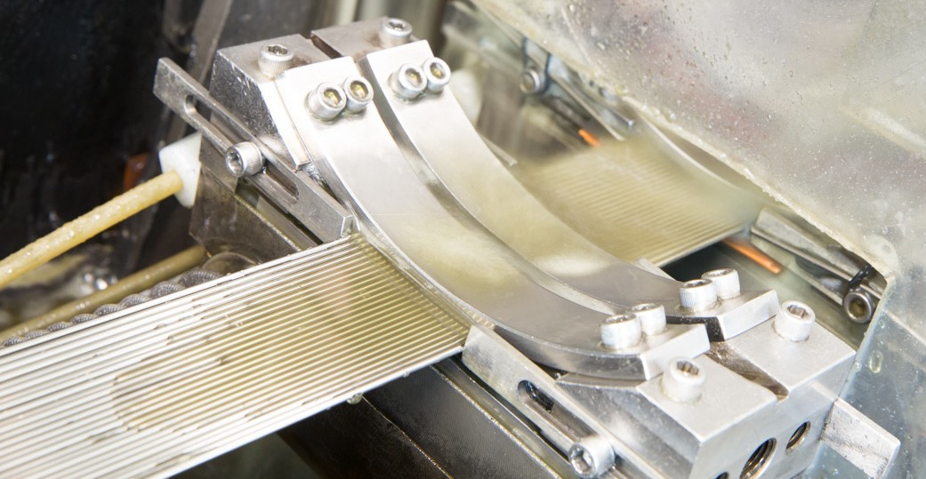
PROCESS
CUTTING
We offer multiple cutting styles:
Shear: crimped end
Score break: 70-90% open
Electrolytic: 100% open, burr free, slight edge break
Laser: 100% open, burr free, sharp edge
Some parts can be tumbled to break edges

Slide 11
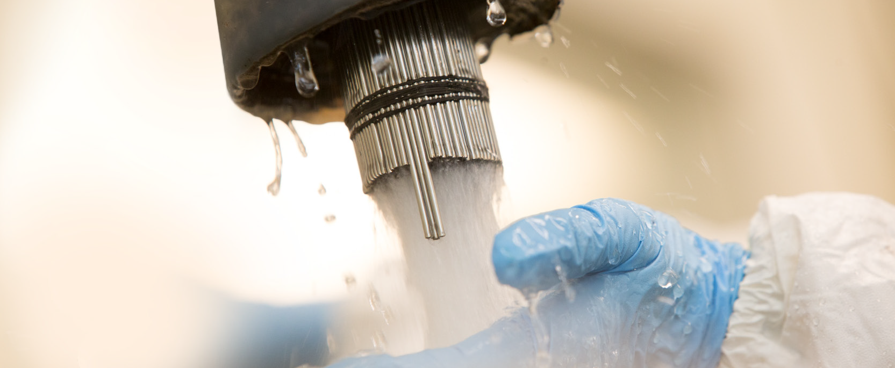
PROCESS
CLEANING
We offer different cleaning methods for different cutting styles:
Shear or score break – OD wipe
Electrolytic – ultrasonic: degreaser, brightened, DI flush
Laser – degreased, pickled, rinsed

Slide 12
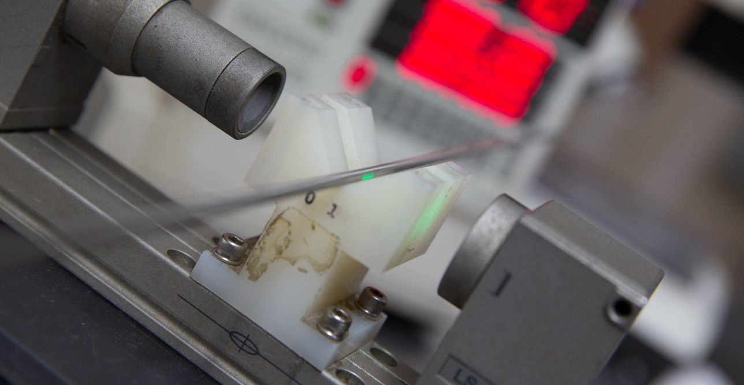
PROCESS
INSPECTION
Quality and metallurgical analysis are conducted.
Physical properties: UTS, YS, %EL, hardness and surface finish
C=0, AQL sampling plan

Slide 13
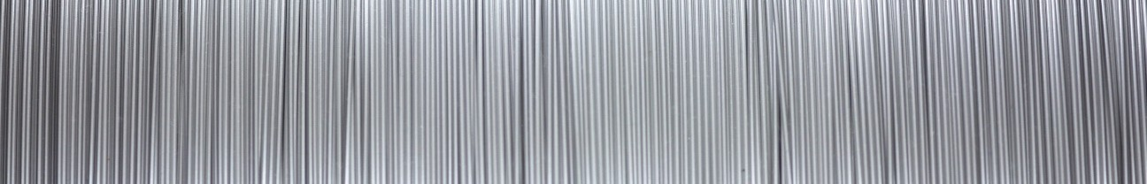
Testing & Certification
OUR CAPABILITIES
Failure Analysis Equipment
  Metallurgy Wet Lab (Mount and Polish)
  Microstructure and Grain Size
  3D Imaging of Fracture surfaces
  Optical Imaging (6x – 3500x)
ISO 9626: Breakage, stiffness and corrosion testing performed in-house.
Physical Property Testing Per ASTM Standards
Tensile Test, Hardness, Surface Finish

Slide 14
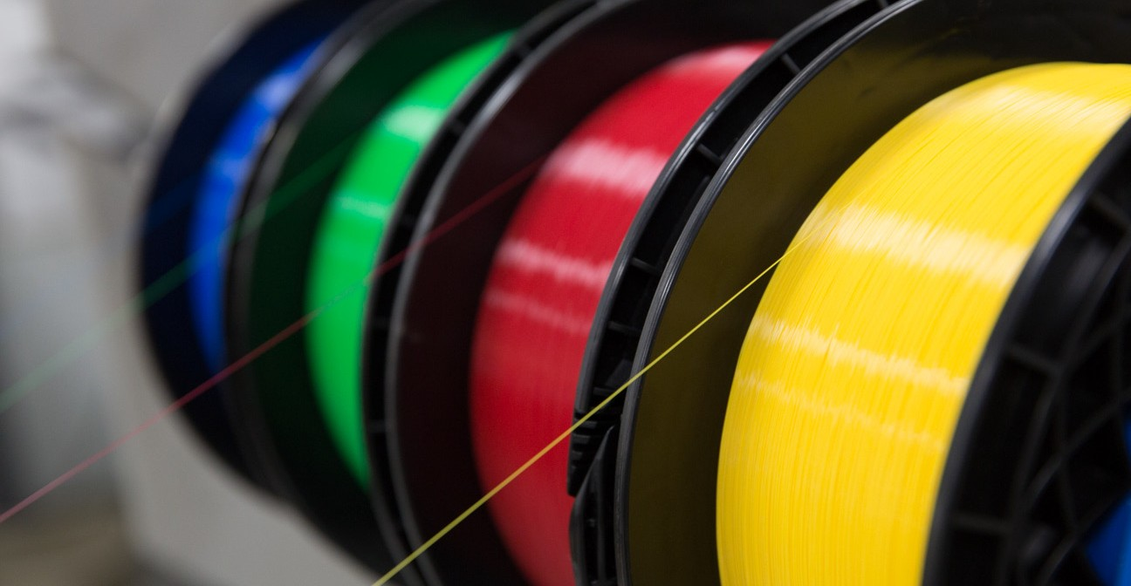
PROCESS
FIBER OPTIC FILLED TUBING
Optical fibers are encapsulated in metal tubing.
Tubing provides strong, leak-free protection for optical fibers.
Fiber optic tubing is shipped on large spools to cable companies.

Slide 15
Current Development Projects
WHAT WE ARE UP TO
Dimensional: Increasing max OD up to .320”, High OD/Wall Ratio Designs
Alloys: Carpenter Proprietary Alloys (465, Bio-Dur), AL6XN (non-magnetic), 1RK91 (PH alloy), additional Inconel grades
Inspection: Final Size Eddy-Current Testing
Fabrications: In-house Flaring, Swaging, Grit Blasting, Electropolish, Laser Cut Fabrication, Induction Annealing

Slide 16





How to Collaborate or Buy
L T’S WORK TOG TH R
For instant access to stock tubing
No request for quote is necessary
Over 100 options available
Easy payment options
Shipped the same day
For custom tubing with unique requirements
Made exactly to your specifications
Total traceability
Quality assurance program for consistency
For design refinements of early-stage projects
Collaborate with the makers of your tubing
Explore alloy options to enhance your decision
Benefit from quick-turnaround manufacturing for early-stage prototypes

Slide 17

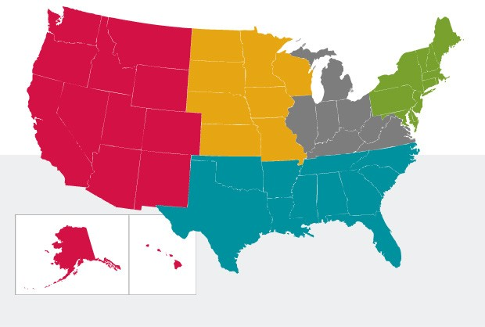
Whatever your question or need, K-Tube is here to assist you.
CONTACT US
Our professional staff is available to assist you with custom projects and provide you with the direction you need to complete your project to specification and on time. We look forward to working with you. Thank you for considering K-Tube.
K-Tube Technologies
sales@k-tube.com
US West
Gary A. Piazza gpiazza@k-tube.com 360.609.7192
US Central
Kevin Shutes kshutes@k-tube.com 847.450.4611
US Central
Medical Metals
MedicalMetals@k-tube.com
Paul Gratiano 603.320.1886
Rich Gordon 203.770.2977
Rich Hecht 203.240.6580
Europe
MER-Europe
+31 598.634.420
Tim Noppert tim@mer-europe.com
Wendy Steenbergen wendy@mer-europe.com
International
sales@k-tube.com
13400 Kirkham Way Poway, CA 92064 USA
US Midwest LifeTech Solutions Jeff L. Johnson
jeffj@lifetechsolutions.com 651.442.9995
US Southeast Chuck Antony cmantony@aol.com 318.243.4119
Toll Free: 800.394.0058
Local: 858.513.9229
Fax: 858.513.9459
www.k-tube.com

